Slide 1

Maharaja Surajmal Institute
Presentation On
Raspberry Pi..
PRESENTED BY-
Vidhya Shankar & Rohann Sabharwal
GUIDE BY-
Ms. Tarunim Sharma

Slide 2
Agenda
¬Introduction
¬History
¬Motivation
¬What is raspberry Pi
¬Features
¬Applications
¬Raspberry Pi Vs Akash Tablet
¬Disadvantages
¬Future Scope

Slide 3
Introduction
The Raspberry Pi is a credit-card
sized computer
It can be plugged into your TV and a keyboard, and can be used for many of the things that your average desktop does - spreadsheets, word-processing, games and it also plays high- definition video.

Slide 4
=
RASPBERRY PI = CPU

Slide 5
Components
Laptop or PC
Raspberry Pi Ver B
Processor
Intel 2.2 Ghz,Dual Core
700 Mhz,Single
Core Arm 11
RAM
6GB
512 MB
Graphics
Intel HD 3000
Dual core video core IV
Ethernet
Yes
Yes
USB 2.0
Yes
Yes
Video O/P
VGA ,HDMI
Composite RCA HDMI
Audio O/P
Yes
Yes
Storage
500 GB Harddisk
32 GB SD Card
Operating System
Linux/Windows
Only Linux
Dimensions
14 inch laptop
8.6x5.4x1.7 cm

Slide 6
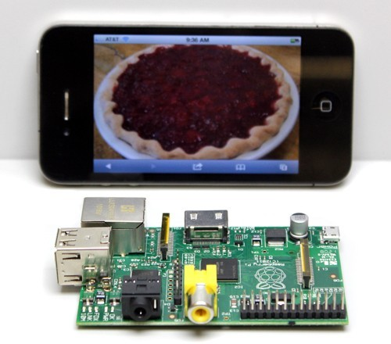
Introduction
measuring approximately 9cm x 5.5cm

Slide 7
History
ϖThe Raspberry Pi is the work of the Raspberry Pi Foundation, a charitable organisation.
ϖUK registered charity (No. 1129409), May 2009
ϖ It's supported by the University of Cambridge Computer Laboratory and tech firm Broadcomm

Slide 8
Motivation
ϖComputer science skills increasingly important
ϖDecline in CS student numbers
ϖAccess to computers
ϖComputers are the tool of the 21st century
ϖComputer Science is concerned with much more than simply being able to use a computer.
ϖChildren should understand how they work and how to program them

Slide 9
What is Raspberry Pi?
The Raspberry Pi is a fully featured micro- computer squashed onto a circuit board measuring approximately 9cm x 5.5cm.

Slide 10
Features
Ultra low-cost (Model A $25, Model B $35)
Ultra low-power ~1W
Credit-card sized, fanless, instant start-up
Complete easy-to-program computer

Slide 11
Features
Provide a fun environment for experimenting with programming and electronics
Inexpensive, simple, open and easy to maintain computer for schools
Fun computer for children to experiment with at home(programming, robotics, etc...)

Slide 12
Hardware
10/100 BaseT Ethernet socket
HDMI socket
USB 2.0 socket
RCA video socket
SD card socket
Powered from microUSB socket
3.5mm audio out jack
Header footprint for camera connection

Slide 13
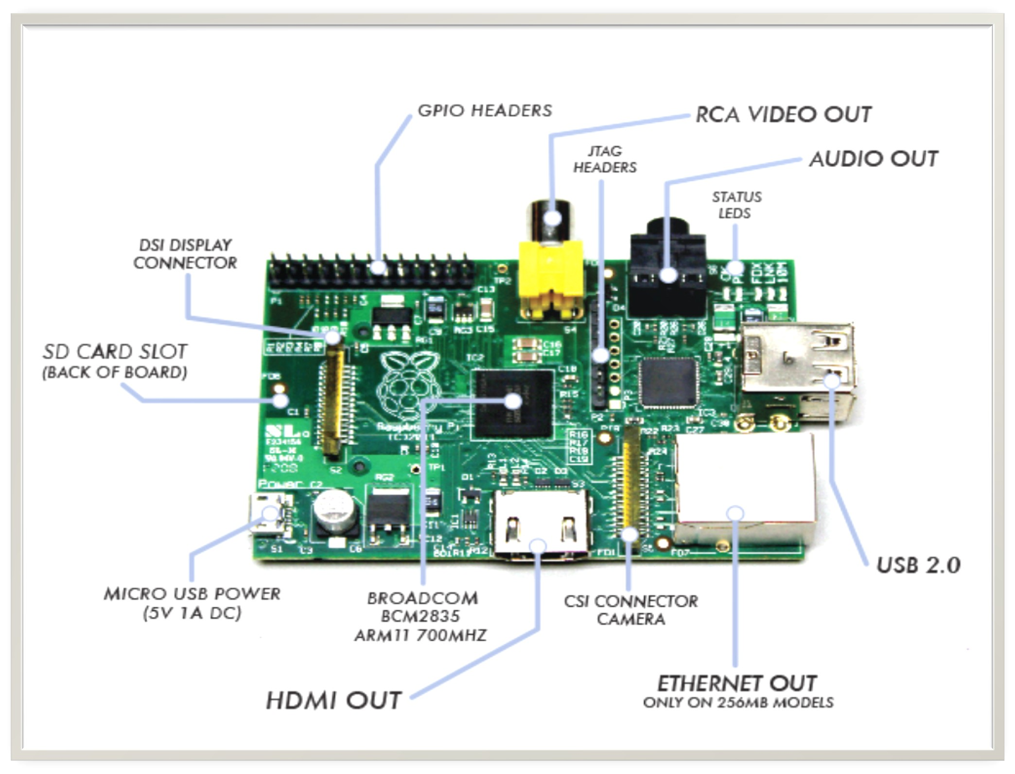

Slide 14
Operating System
Linux on a bootable SD card
Fedora
Raspbian
Debian
ArchLinux ARM

Slide 15
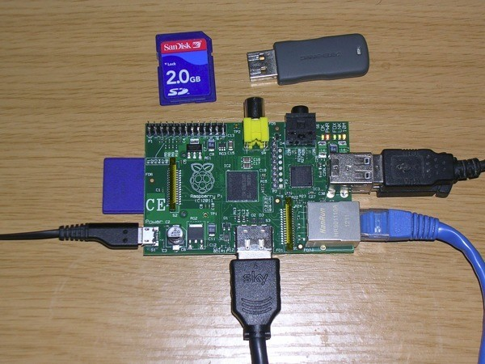
How to make it work!

Slide 16
Programming
By default, supporting Python as the educational language.
Any language which will compile for ARMv6 can be used with the Raspberry Pi.

Slide 17
Price
Model A - $ 25
Model B - $ 35
Why so cheap ?
SoC - System on a chip, a computer on a single low voltage chip
Linux OS

Slide 18
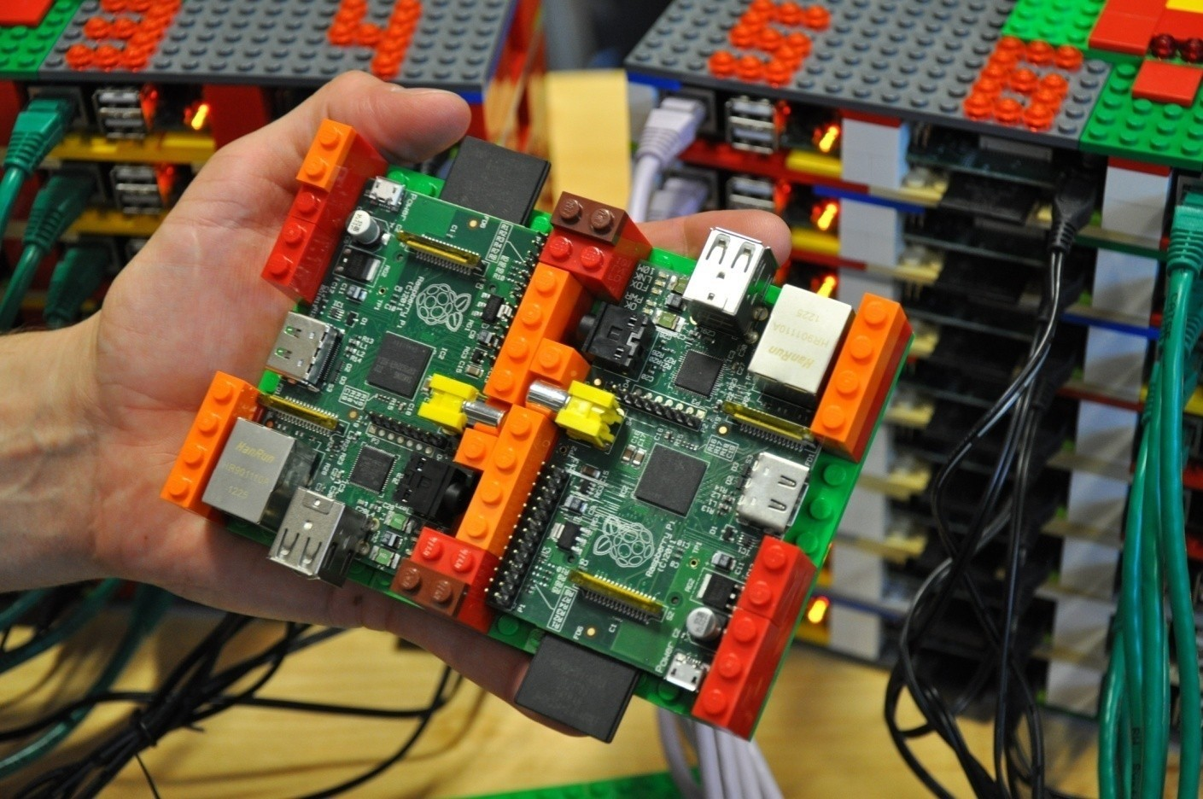
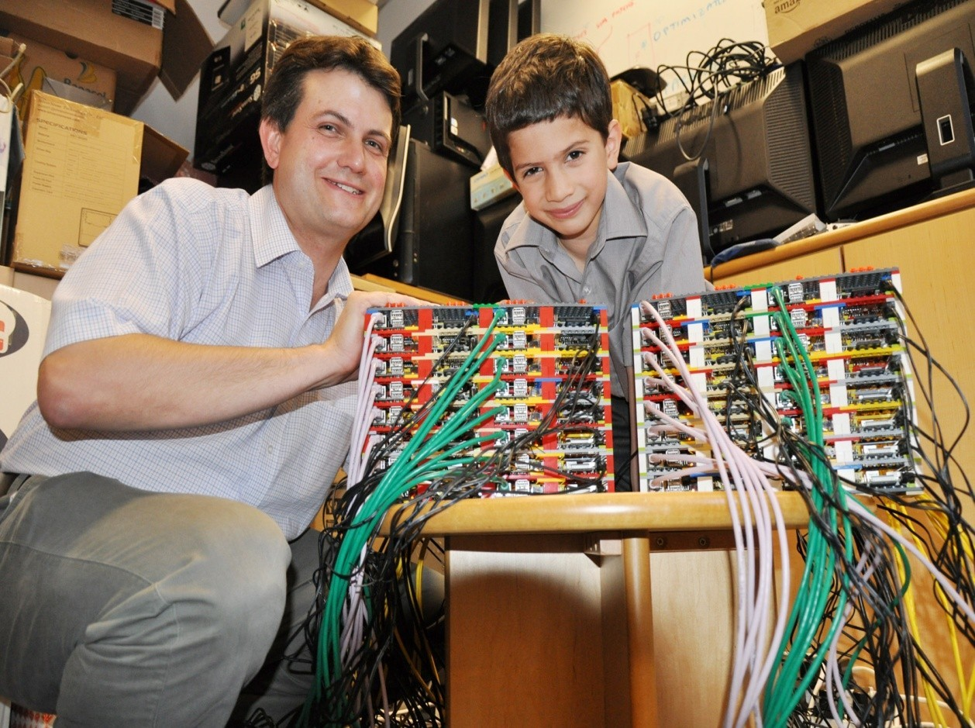
Applications
Can be used for making super computers

Slide 19
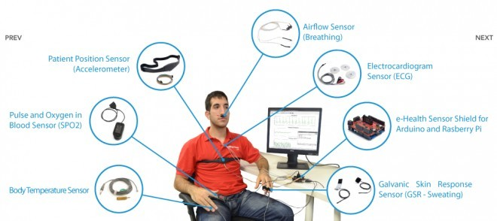
Applications
Raspberry Pi Medical Device Input Shield

Slide 20
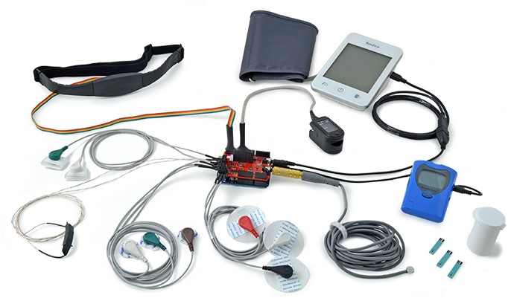

Slide 21
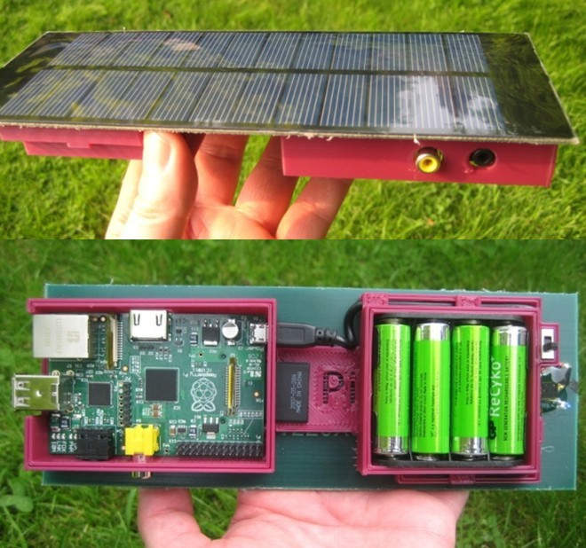
Applications
Solar Raspberry Pi Power Pack

Slide 22
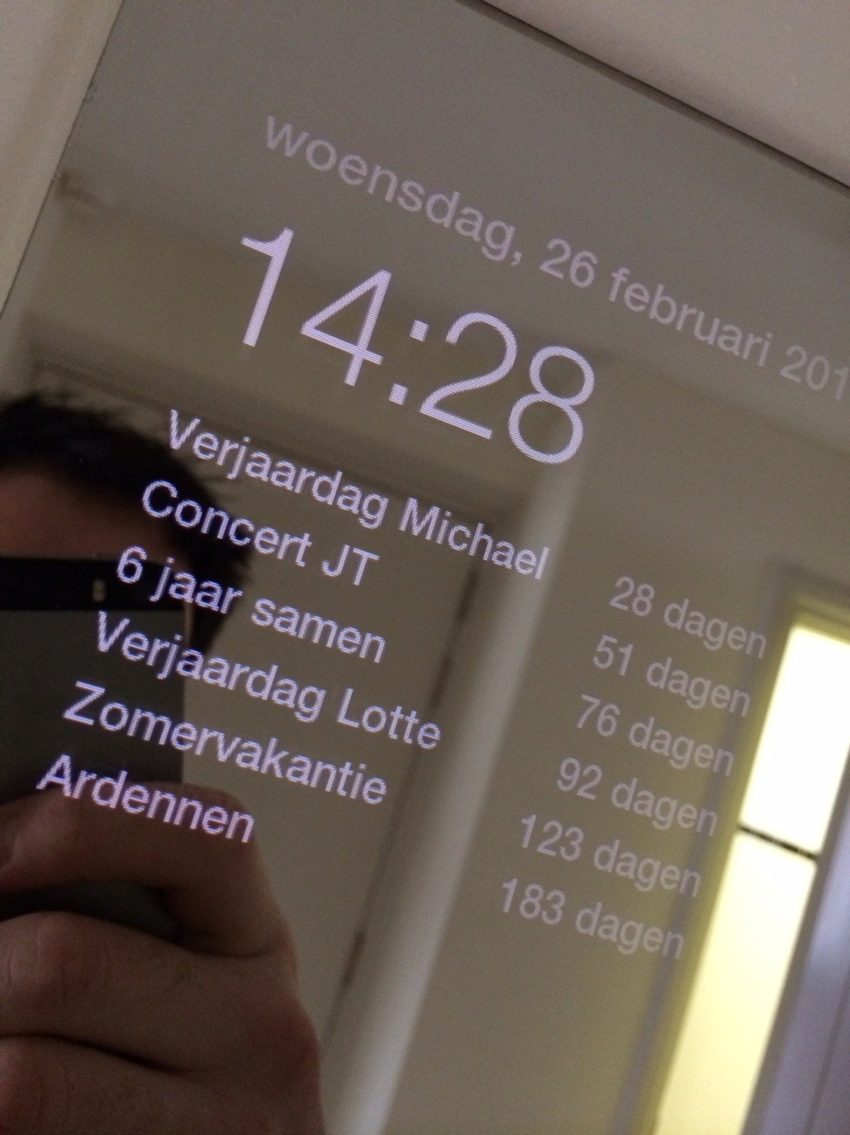
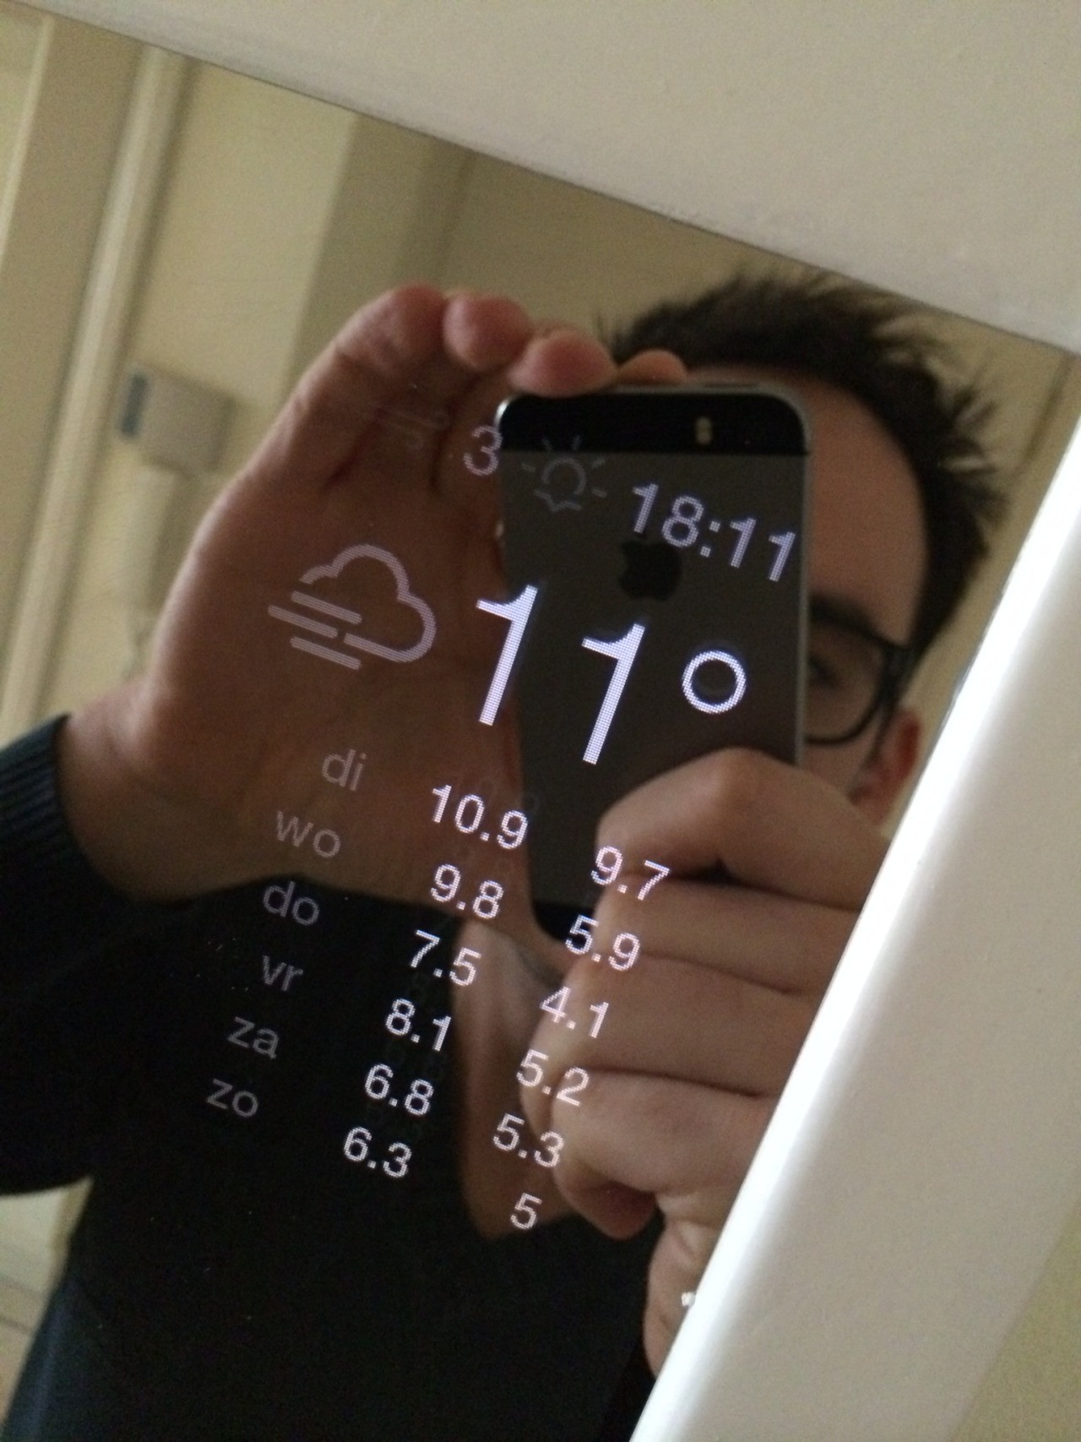
MAGIC MIRRIOR WITH RASPBERRY PI

Slide 23
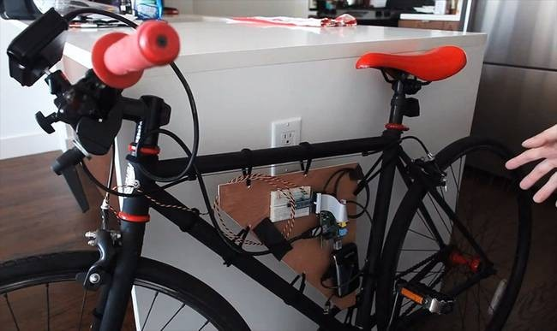
Applications
•
•
•
Voice-Activated Coffee Machine
https://vimeo.com/54300364
Raspberry Pi Dynamic Bike Headlight Prototype

Slide 24

Applications
•
It can make your Old TV in to a smart TV. (You can play Videos, 3D Games, Music, Browse Internet and much more.
Raspberry Pi can Act as Full HD 1080p Media Player. Its a Mini Computer which just cost Rs.2,350/-
You can connect a Monitor, Keyboard and Mouse and use it as a normal computer.
Its Graphics Capabilities is better than Apple Products.
•
•
•
•

Slide 25
Raspberry Pi Vs Akash
Aakash is a low-cost tablet, and Raspberry Pi is an ultra-cheap, customizable computer.
Both tech innovations have education and economy as their central goals.
Aakash could fundamentally change the way Indian students and most of rural India connects with the Internet.

Slide 26
Disadvantages
•
It does not have a Hard Disk associated with it
for permanent storage pf files,we have to connect one externally or have to use SD card for the purpose.
The RAM is a POP package on top of the SoC, so it’s not removable or swappable.
There is no Real time clock associated with the board.Adding an RTC is expensive. You can add one yourself using the GPIO pins.

Slide 27
Future developments
Tablet version
Interesting low-cost screen technologies emerging
Brambles! (Networks of Raspberries)

Slide 28
Raspberry Pi 2020
Exploit process scaling and keep price constant:
8 cores, improved GPU, 8GB main memory
WiFi, camera, matchbox sized case
holographic laser projector, virtual keyboard
FPGA logic on main SoC, high speed links, ….
– < $25

Slide 29
REFERENCES
G.Senthilkumar1, K.Gopalakrishnan2, V. Sathish Kumar3 Embedded Image Capturing System Using Raspberry Pi System,Volume 3, Issue 2March–April 2014 Page 213.
Umesh P Image Processing in Python, CSI Communications,December 2012.
Raspberry pi – www.raspberrypi.org

Slide 30
CONCLUSION
Raspberry Pi is an innovative product. The sheer number of users and fan base support the fact that the device can see a great future ahead. The device can surely help
•
anyone who really wants to lean electronics and
computers.
Finally it can be said that Raspberry Pi can be effectively used if its processing power is kept in mind. It can work as a personal computer but cannot replace it.
•

Slide 31
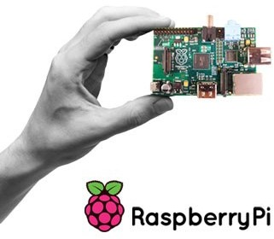
THANK YOU

